Slide 1
How to Ask the Right Question: Choosing Estimands for Health Policy Research
Enar 2025
Nicholas J. Seewald, PhD
Assistant Professor of Biostatistics
24 March 2025

Slide 2

Slides are online!
slides.nickseewald.com/enar2025.pdf

Slide 3

Context for this talk
Scan for slides
This talk is a (very) early attempt to build a framework for translating policy evaluation questions to estimands.
Feedback & ideas are encouraged!
Some of the ideas come out of this paper:

Slide 4
The Goal of Policy Evaluation
Scan for slides
In general:
“What is the effect of [a policy] on [outcome(s) of interest] over [a defined period of time], relative to what would have happened in the absence of the policy?”

Slide 5
Policy Evaluation is Hard
Policies are heterogeneous
Policies aren’t implemented in a vacuum
Small sample sizes
Confounding by time
Policymakers need to understand results

Slide 6
Formalizing an Estimand
“What is the effect of [a policy] on [outcome(s) of interest] over [a defined period of time], relative to what would have happened in the absence of the policy?”
Answering this, and translating it to an estimand, requires operationalizing
Who
What
When
Where
(Why)

Slide 7
Good Design Helps
Careful thinking about study design helps in defining a causal contrast
Clear definitions of exposure & comparison conditions
Clear thinking about “time zero”
Clear identification of eligible units under study

Slide 8
Who are we studying?

Slide 9



Units and Eligibility Criteria
Policy evaluations must consider
“Policy-level” units that could implement the policy or comparison condition
“Impact-level” units that the policy is designed to affect and on which outcomes are measured.
Policy-Level Unit
Impact-Level Unit
Impact-Level Unit
Impact-Level Unit

Slide 10
Units and Eligibility Criteria
Policy evaluations must consider
“Policy-level” units that could implement the policy or comparison condition
“Impact-level” units that the policy is designed to affect and on which outcomes are measured.
Policy-Level Unit
Impact-Level Unit
Notes:
As an example here, consider

Slide 11
Policy-Level Units
Policy-level units are
units that did implement the policy or did implement the comparison condition
at “time zero” / “study entry” (ideally), and
monitored longitudinally
Eligibility criteria should be based only on pre-policy information:
“has not implemented the policy before” or more complex (e.g., “has not previously implemented policies X, Y, Z”)

Slide 12
Impact-Level Units
Impact-level units are those that the policy is designed to affect. Possibly
the policy-level units themselves, or
sub-units nested in policy-level units on which outcomes are measured, ideally from the population the policy is designed to affect.
Eligibility would be based only on pre-policy information:
“Lives in state X” for policies that apply to everyone
“Lives in state X and was diagnosed with Y before the policy”, etc.
Retention efforts if impact-level units followed longitudinally

Slide 13
What are we studying?
What does it mean to say $A_{i}=a$?

Slide 14
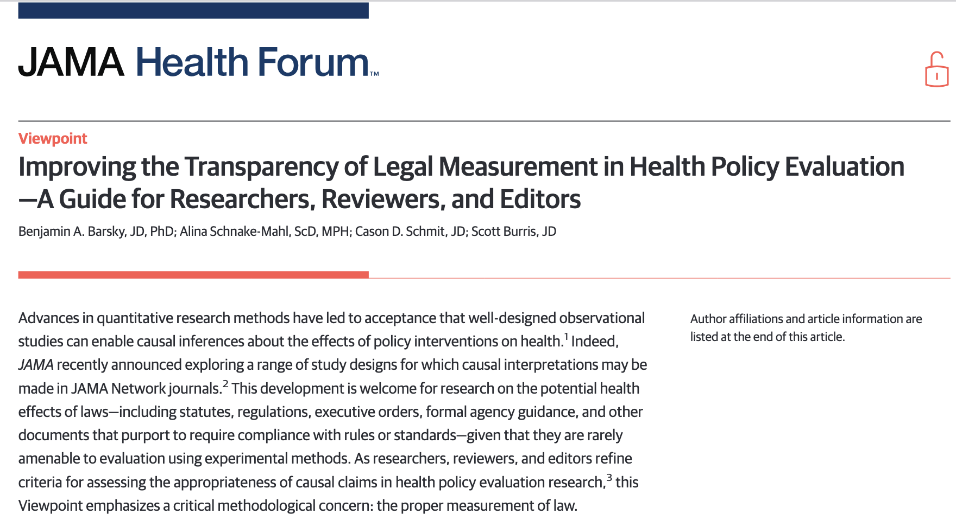
Defining the Exposure
“Legal epidemiology”
Rigorous & transparent framework for analysis of laws / policies
Use qualitative methods to identify a class (or small number of classes) of similar policies that will be the exposure(s).
Definition should be precise to help disentangle effects of interest & avoid confounding policies.

Slide 15
Defining the Comparison Group
Best practices:
At time zero, the comparison group is every policy-level unit that has not been exposed at that time
If unexposed units become exposed later, censor their outcomes when they become exposed.
This ideal design isn’t always practical for policy evaluations.

Slide 16
Choosing Comparators for Policy Evaluation
Unexposed at Baseline
Never Exposed
Avoids conditioning on post-treatment information
Allows the comparison group to change (possibly meaningfully) over time.
Is an observed effect due to the policy or the changing comparison group?
Chosen using knowledge of future policy status – could lead to bias!
Clearly not ideal, but the comparison group remains unchanged over time.

Slide 17
Never-Exposed Comparators
Very commonly used in policy evaluations, but
Studies that choose to use never-exposed comparators are subject to additional assumptions about the comparability of ever- and never-exposed units and are subject to bias.
Options for redesigning the study:
Change policy-level eligibility criteria to de facto exclude likely bad comparators (geography, urbanicity, etc.). Pay attention to remaining sample size!
Limit the follow-up period to one in which good comparators exist.

Slide 18
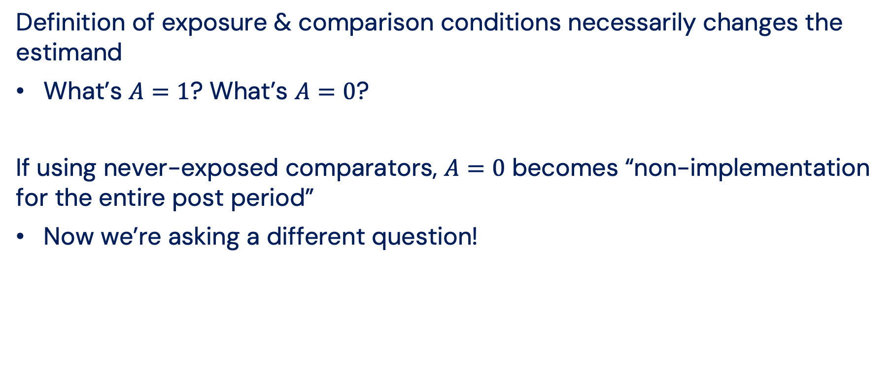
Impact on the Estimand
Definition of exposure & comparison conditions necessarily changes the estimand
What’s $A=1$? What’s $A=0$?
If using never-exposed comparators, $A=0$ becomes “non-implementation for the entire post period”
Now we’re asking a different question!

Slide 19
Measurement & Outcomes
What are we measuring? What does the estimand actually mean?
All sorts of messiness here:
Retrospective analysis limits us to already-collected data
Questions about measurement
Data might not be available for the target population
Even more complexity:
Degree of implementation can be highly variable, but this can be very difficult to measure. (Work is ongoing!)

Slide 20
When are we studying the policy?

Slide 21
Policy evaluation is naturally longitudinal
We must have longitudinal data before and after policy implementation to evaluate the policy!
Policy effects are likely time-varying
Ramp-ups, delayed effects, waning effects, etc.
Policies aren’t implemented in a vacuum
Policy-level units are doing other stuff around the same time!
Legislative packages, phased rule changes, etc.
“Current events are happening as we speak” -Matt Rogers, Las Culturistas
Griffin BA, et al. Methodological considerations for estimating policy effects in the context of co-occurring policies. Health Serv Outcomes Res Method 2023;23:149–65.

Slide 22
Study Periods
Defining a study period can be difficult!
Estimation methods typically rely on “long-enough” pre-periods (e.g., synthetic controls)
But, if you go too far back, you could model “old” dynamics
Longer follow-up periods are interesting: what’s the effect of the policy X years after implementation?
But, if other things happen, we could accidentally attribute “new” dynamics to the “old” policy.

Slide 23
Translation to an Estimand
Do we care about estimating a policy effect
at a single point in time?
over some specific follow-up period?
over the entire follow-up period?
Current best practice is probably to estimate time-specific effects on as granular a level as possible, then think carefully about aggregation to a desired interval
See, e.g., Callaway & Sant’Anna’s “group-time ATTs”
Callaway B, Sant’Anna PHC. Difference-in-Differences with multiple time periods. J Econometrics 2021;225:200–30.

Slide 24
Where are we studying the policy?

Slide 25
Place is (very likely) important
Policy-level units are commonly non-exchangeable
States, e.g., can be quite different from each other
Geographically proximal controls can help improve face validity
But, that could introduce interference or spillover.

Slide 26
Impact of Geography on the Estimand
Usual interference approaches bundle together units
Estimand becomes effect on outcomes under “bundled” treatments across interfering units
Might not be ideal in settings with small N (e.g., state policy)
Bundling units can lead to even less power

Slide 27
Who is this for?
“Who” part deux

Slide 28
Who is the question for?
Policymakers (hopefully) want to know what will happen if they implement something
Question of interest for PA probably isn’t “What happened in MD”, but “What will happen in PA?”
Requires a different counterfactual than what we usually estimate
Cairney P. The myth of ‘evidence-based policymaking’ in a decentred state. Public Policy and Administration 2022;37:46–66.

Slide 29
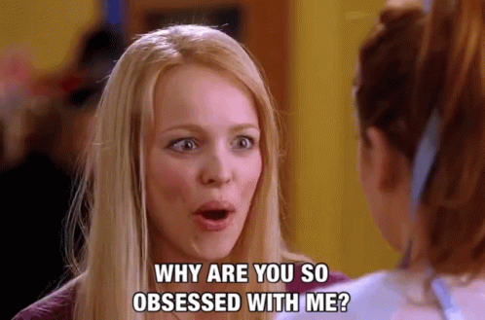
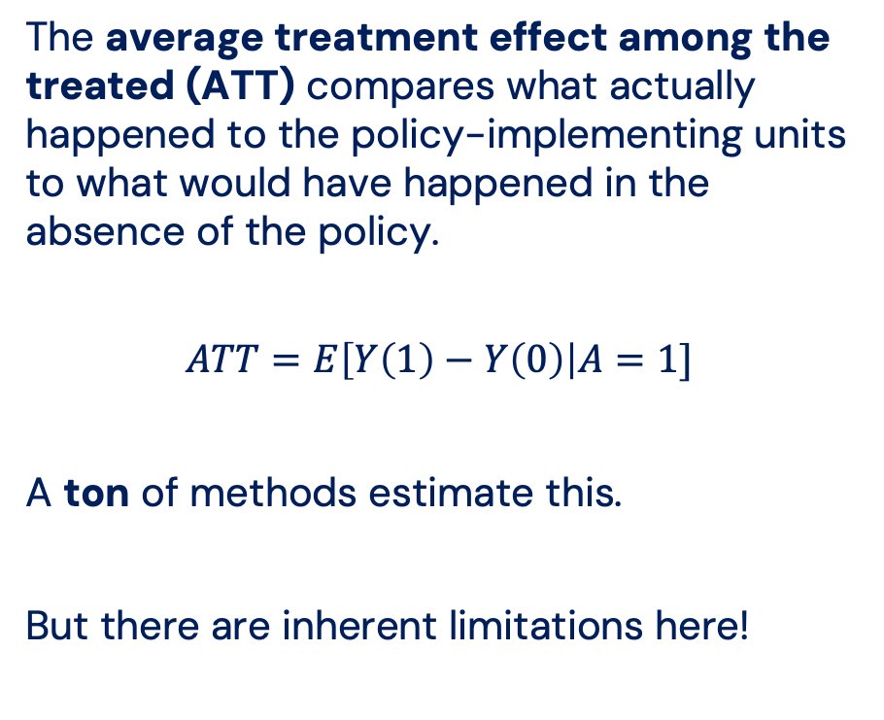
We all love the ATT
The average treatment effect among the treated (ATT) compares what actually happened to the policy-implementing units to what would have happened in the absence of the policy.
$$ATT=E\left[Y\left(1\right)−Y\left(0\right)\right|A=1]$$
A ton of methods estimate this.
But there are inherent limitations here!

Slide 30
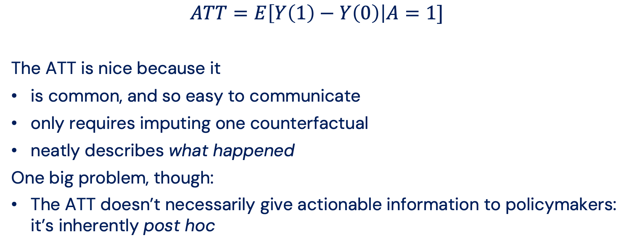
Pros and Cons of the ATT
$$ATT=E\left[Y\left(1\right)−Y\left(0\right)\right|A=1]$$
The ATT is nice because it
is common, and so easy to communicate
only requires imputing one counterfactual
neatly describes what happened
One big problem, though:
The ATT doesn’t necessarily give actionable information to policymakers: it’s inherently post hoc

Slide 31
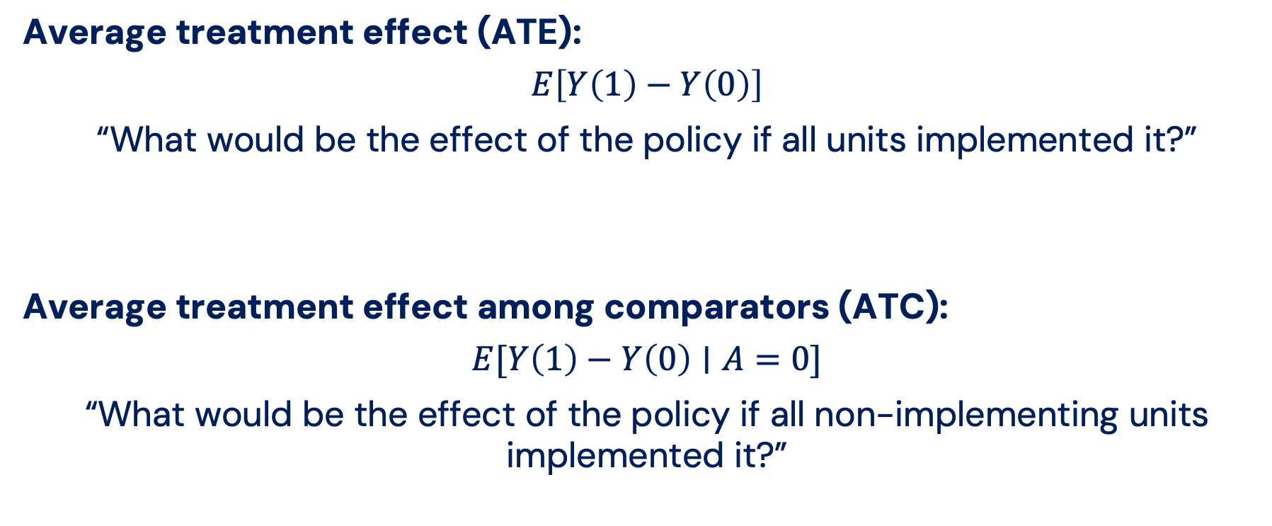
Other Common Simple Estimands
Average treatment effect (ATE):
$$E\left[Y\left(1\right)−Y\left(0\right)\right]$$
“What would be the effect of the policy if all units implemented it?”
Average treatment effect among comparators (ATC):
$$E[Y\left(1\right)−Y\left(0\right)∣A=0]$$
“What would be the effect of the policy if all non-implementing units implemented it?”

Slide 32
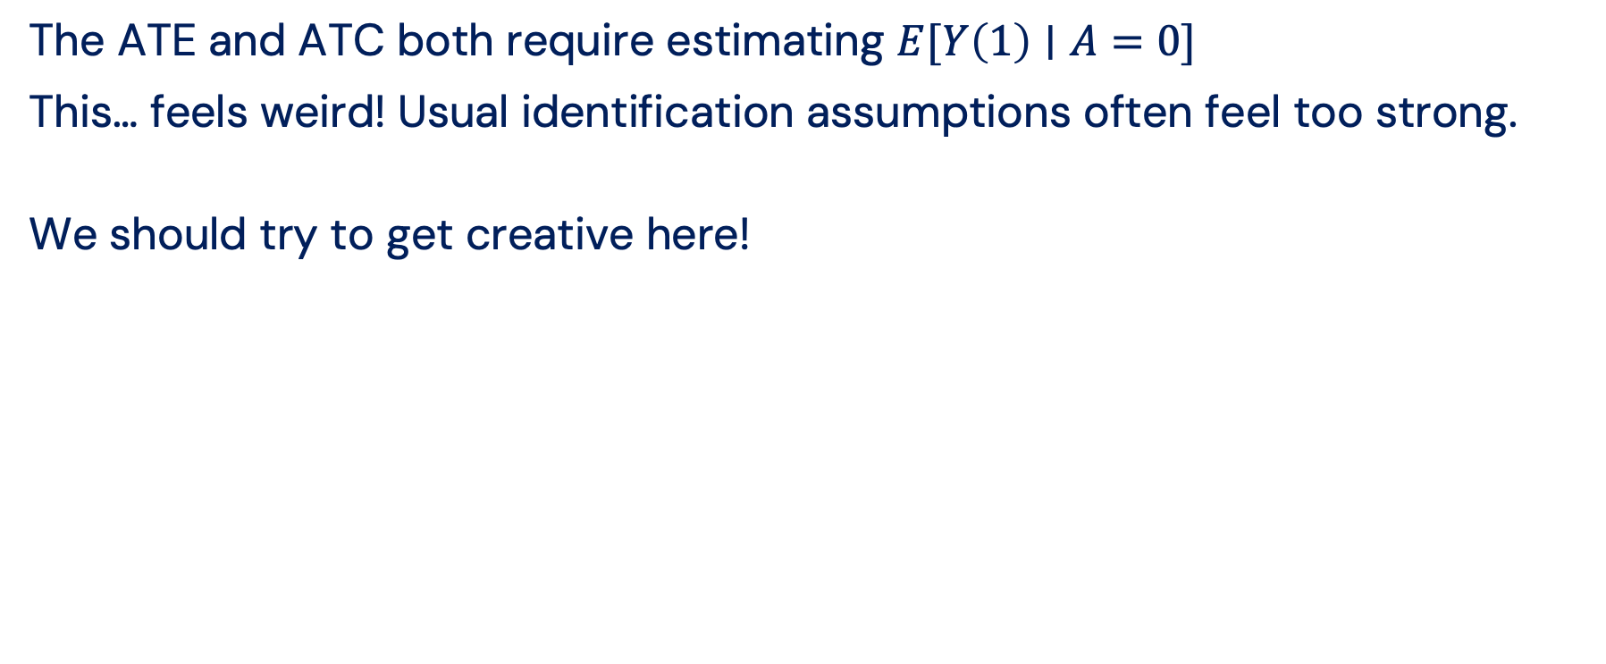
Why do we prefer the ATT?
The ATE and ATC both require estimating $E[Y\left(1\right)∣A=0]$
This… feels weird! Usual identification assumptions often feel too strong.
We should try to get creative here!

Slide 33
Where can we go from here?

Slide 34
Policy evaluation is hard.
Scan for slides
Understanding the effects of a policy is really challenging by nature.
Design thinking can help, but engagement with substantive expertise and different ways of thinking (including qualitative research!) is critical.
We need to think creatively when building methods.

Slide 35
Where can we go from here?
Scan for slides
Throughout the session, we’ll see creative thinking being used to address complex policy questions:
How do we handle heterogeneous exposures? (Gary)
How do we handle recurrent events? (Arman)
How do we handle spillover & heterogeneity thereof? (Fei)

